Slide 1
Formal Proof Generation (Cont.) – Thor & Baldur
Huangzhao Zhang
zhang_hz@pku.edu.cn

Slide 2
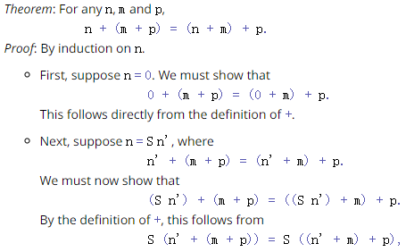
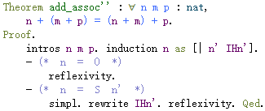
Proof
Proof – A proof is an act of communication (Software Foundations)
A proof of a mathematical proposition P is a written (or spoken) text that instills in the reader or hearer the certainty that P is true -- an unassailable argument for the truth of P.
Informal proof – “Algorithm”
Formal proof – “Code”

Slide 3
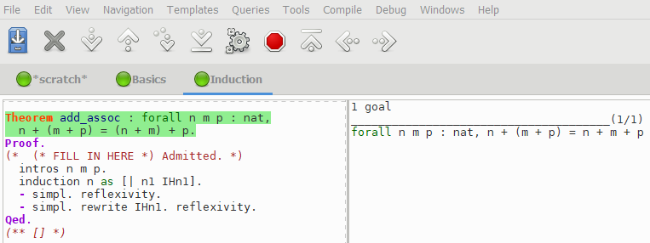
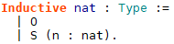
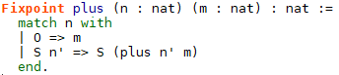
Formal Proof – A Coq Example
Theorem – For all natural number $n,m,p$, we have
$$n+\left(m+p\right)=\left(n+m\right)+p$$
Natural number
O, S O, S (S O), S (S (S O)), …
Addition

Slide 4
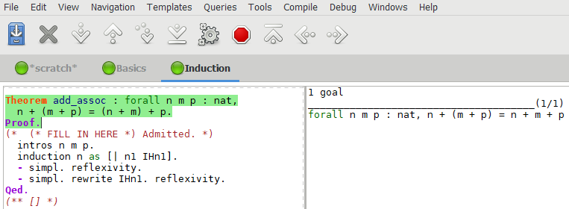
Formal Proof – A Coq Example
Theorem – For all natural number $n,m,p$, we have
$$n+\left(m+p\right)=\left(n+m\right)+p$$
Natural number
O, S O, S (S O), S (S (S O)), …
Addition

Slide 5
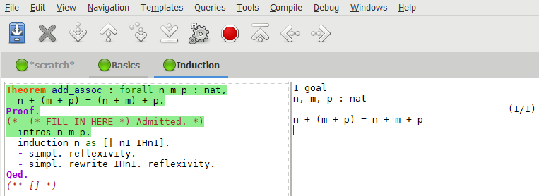
Formal Proof – A Coq Example
Theorem – For all natural number $n,m,p$, we have
$$n+\left(m+p\right)=\left(n+m\right)+p$$
Natural number
O, S O, S (S O), S (S (S O)), …
Addition

Slide 6
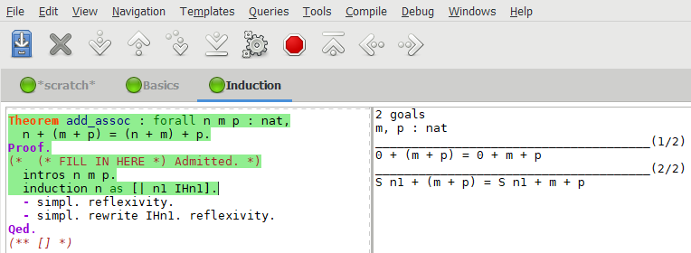
Formal Proof – A Coq Example
Theorem – For all natural number $n,m,p$, we have
$$n+\left(m+p\right)=\left(n+m\right)+p$$
Natural number
O, S O, S (S O), S (S (S O)), …
Addition

Slide 7
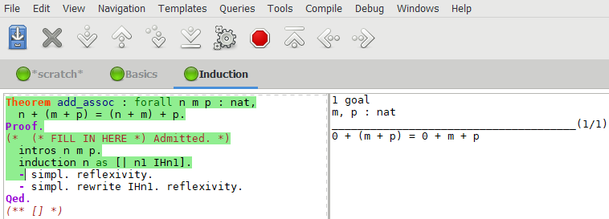
Formal Proof – A Coq Example
Theorem – For all natural number $n,m,p$, we have
$$n+\left(m+p\right)=\left(n+m\right)+p$$
Natural number
O, S O, S (S O), S (S (S O)), …
Addition

Slide 8
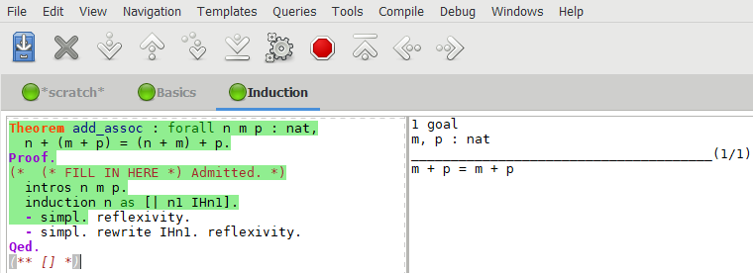
Formal Proof – A Coq Example
Theorem – For all natural number $n,m,p$, we have
$$n+\left(m+p\right)=\left(n+m\right)+p$$
Natural number
O, S O, S (S O), S (S (S O)), …
Addition

Slide 9
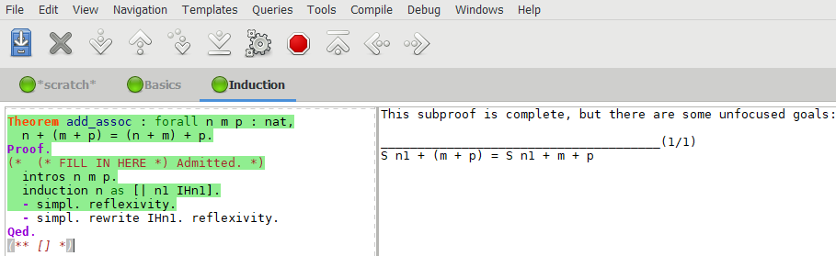
Formal Proof – A Coq Example
Theorem – For all natural number $n,m,p$, we have
$$n+\left(m+p\right)=\left(n+m\right)+p$$
Natural number
O, S O, S (S O), S (S (S O)), …
Addition

Slide 10
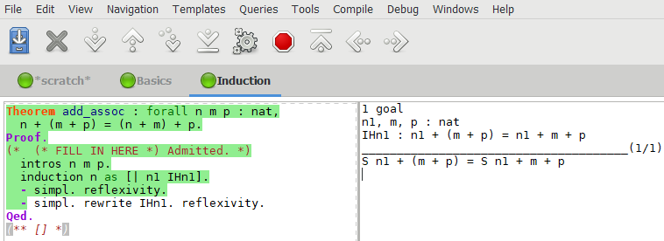
Formal Proof – A Coq Example
Theorem – For all natural number $n,m,p$, we have
$$n+\left(m+p\right)=\left(n+m\right)+p$$
Natural number
O, S O, S (S O), S (S (S O)), …
Addition

Slide 11
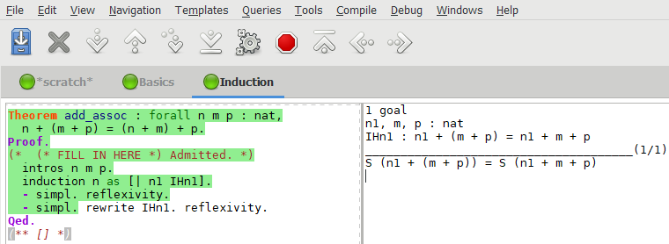
Formal Proof – A Coq Example
Theorem – For all natural number $n,m,p$, we have
$$n+\left(m+p\right)=\left(n+m\right)+p$$
Natural number
O, S O, S (S O), S (S (S O)), …
Addition

Slide 12
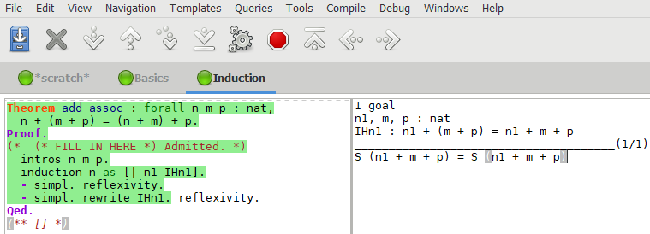
Formal Proof – A Coq Example
Theorem – For all natural number $n,m,p$, we have
$$n+\left(m+p\right)=\left(n+m\right)+p$$
Natural number
O, S O, S (S O), S (S (S O)), …
Addition

Slide 13
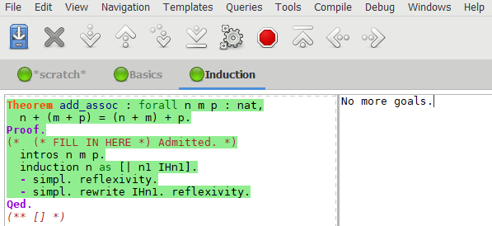
Formal Proof – A Coq Example
Theorem – For all natural number $n,m,p$, we have
$$n+\left(m+p\right)=\left(n+m\right)+p$$
Natural number
O, S O, S (S O), S (S (S O)), …
Addition

Slide 14
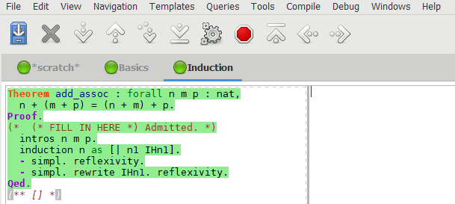
Formal Proof – A Coq Example
Theorem – For all natural number $n,m,p$, we have
$$n+\left(m+p\right)=\left(n+m\right)+p$$
Natural number
O, S O, S (S O), S (S (S O)), …
Addition

Slide 15
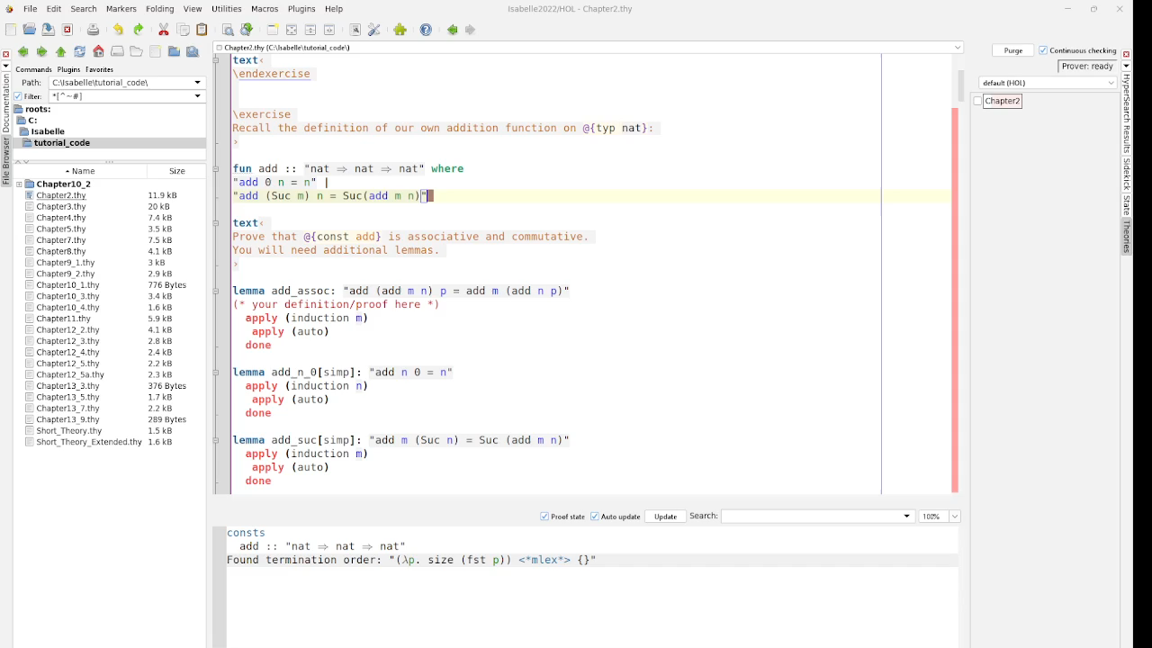
Formal Proof (2) – Another Isabelle Example

Slide 16
Formal Proof (3)
Interactive theorem proving – Higher order logic (HOL)
Coq – Four-color theorem, …
Isabelle – Sledgehammer, Isabelle Archive, …
Lean
…

Slide 17
Automated Formal Proof
 | Formal proof generation | Source code generation
Requirement | Informal proposition | NL description
How-to-do | Informal proof | Algorithm
Signature | Formal proposition | Function declaration
Body | Formal proof | Function body
Dependency | Other lemmas, etc. | Other functions, etc.
Input
Model
Output

Slide 18
Automated Formal Proof (2)
Violence – Traverse all plausible proofs
Sledgehammer – Isabelle
Search – Predict the next most likely proof step
Thor
Generative LM
Baldur

Slide 19
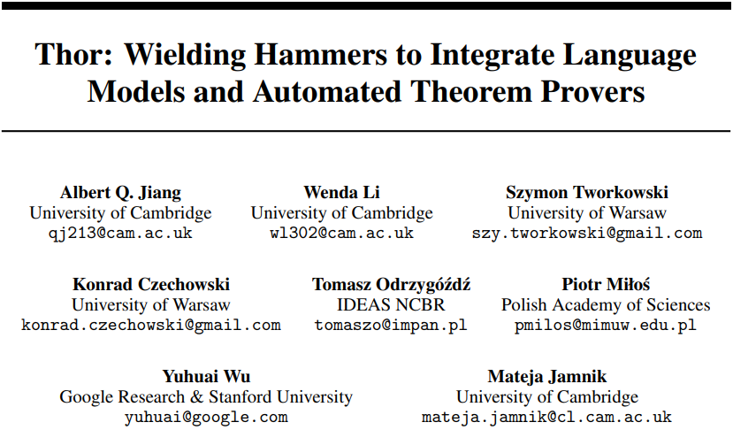

Slide 20
A Quick Glance at Thor
Premise selection from a library is hard for LM
Thor – LM + hammer
Hammer – Premise selection
LM – Other work, such as reasoning and planning
Similar to ToolFormer
Conclusion
Disentangles the planning stage of the next proof step (LM) and premise selection (hammer) is feasible

Slide 21
LM for Theorem Proving
Interactive generation
Step-by-step

Slide 22
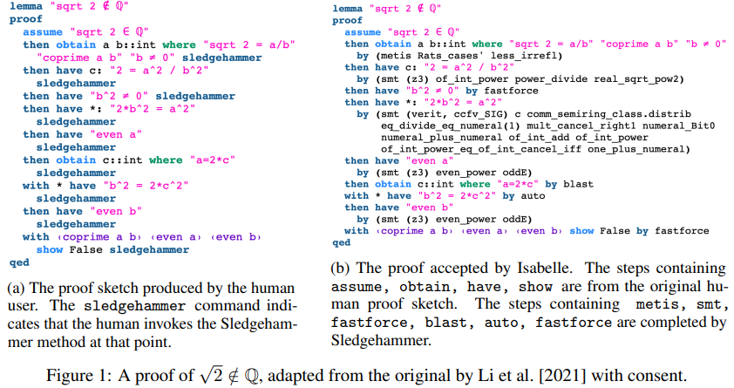
Hammer
Sledgehammer
Almost brute force
Automate simple proof steps

Slide 23
Thor
“HammerFormer”
If need hammer – Generate <hammer> & wait for hammer results
Otherwise – Regular generation

Slide 24
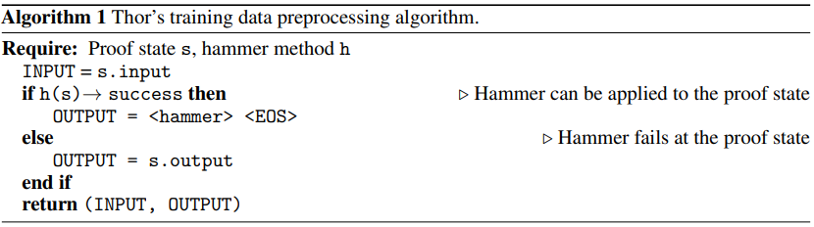
Thor (2)
Raw
Processed

Slide 25
Evaluation Setup
LM – Decoder-only transformer
GPT-2 tokenizer – Vocabulary size = 50400
RoPE, Non-embedding param size = 700M
Pretrained on GitHub + arXiv
Dataset
PISA – Archive of Formal Proofs (Isabelle) with 2.5M instances
95% training + 1% validation + 4% testing
Randomly select 3k theorems for final evaluation
MiniF2F – 488 high school math problems (Lean, Metamath, Isabelle)
244 validation + 244 testing

Slide 26
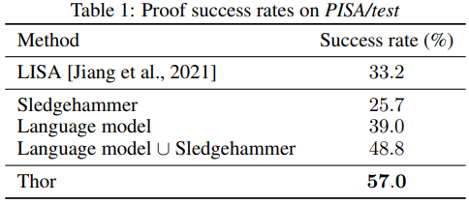
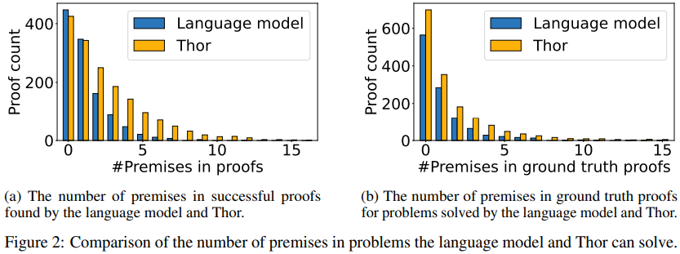
Experimental Results
Thor vs. LM or hammer
Thor helps premise selection

Slide 27
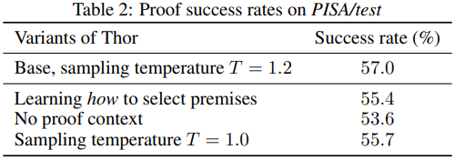
Experimental Results (2)
How to select premises
Training – Original raw data
Inference – Invoke hammer when “sledgehammer” is generated
No proof context
Remove previous proof steps from the input
Sampling diversity

Slide 28
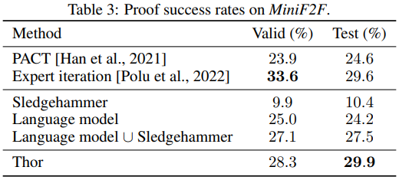
Experimental Results (3)
Thor vs. other solutions

Slide 29
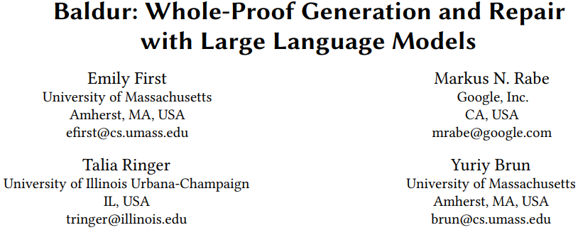

Slide 30
A Quick Glance at Baldur
Software property verification – Desirable but hard
Baldur – LLM for automated formal verification
Generation model – Whole proof generation
Repair model – Erroneous proof repairing
Evaluation – AFP (mostly math theorems)
Conclusion
LLM for formal verification is feasible
Addition context (ICL) is beneficial

Slide 31
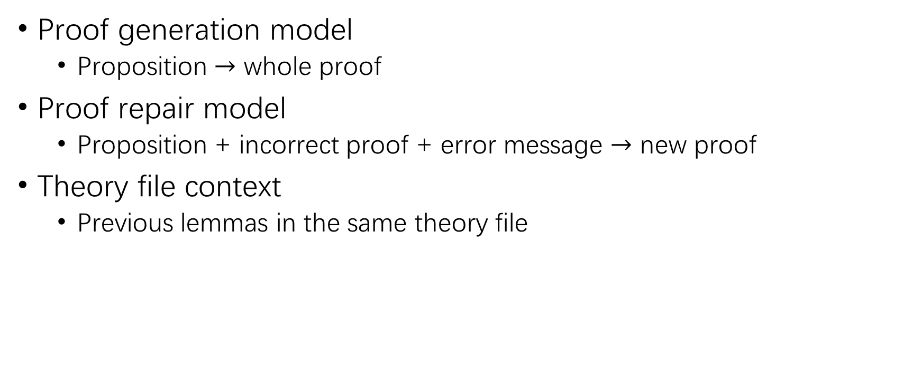
Baldur Framework
Proof generation model
Proposition $→$ whole proof
Proof repair model
Proposition + incorrect proof + error message $→$ new proof
Theory file context
Previous lemmas in the same theory file

Slide 32
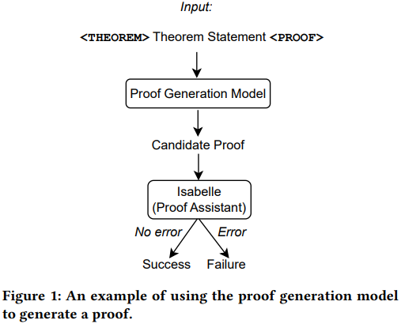
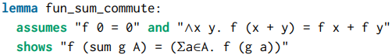
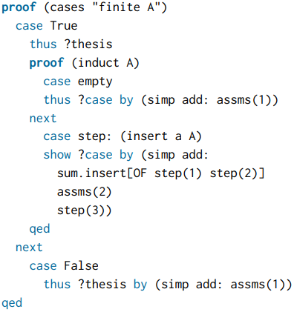
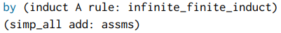
Proof Generation
Proposition
Ground-truth
LLM generated

Slide 33
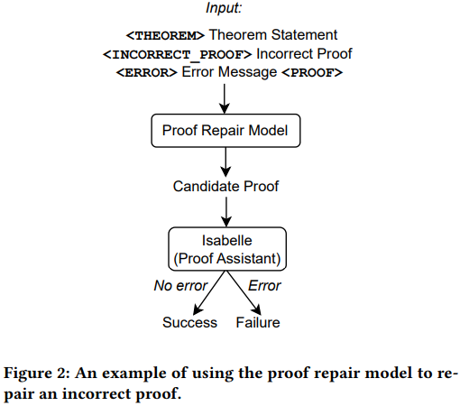
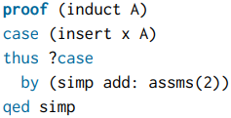
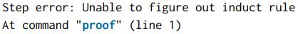
Proof Repair
Proposition
Incorrect proof
Error message

Slide 34
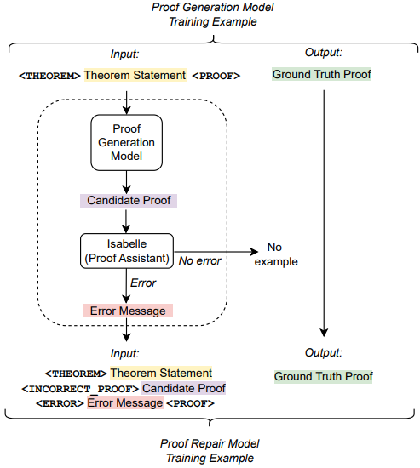
Training Data Creation

Slide 35
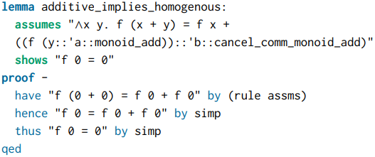
Additional Context
Context vs. premise
Context – Preceding lines (lemmas, definitions, etc.) of the proposition
Premise – Definitions and previously proven lemmas that assist to prove the current proposition
Context
(preceding lemma)
Current Proposition

Slide 36
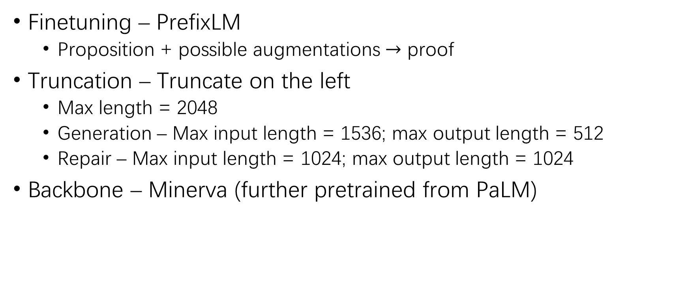
Baldur Implementation
Finetuning – PrefixLM
Proposition + possible augmentations $→$ proof
Truncation – Truncate on the left
Max length = 2048
Generation – Max input length = 1536; max output length = 512
Repair – Max input length = 1024; max output length = 1024
Backbone – Minerva (further pretrained from PaLM)

Slide 37
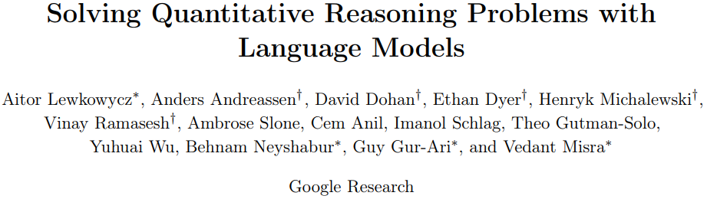

Slide 38
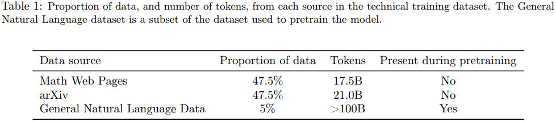
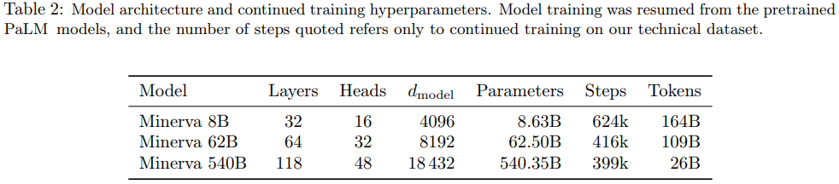
Minerva

Slide 39
Evaluation Setup
PISA dataset
95% training + 1% validation + 4% testing
Complete testset – 6,633 theorems in total; 6,336 theorems after filtration

Slide 40
Evaluation Setup (2)
RQ1: How effective are LLMs at generating whole proofs?
RQ2: Can LLMs be used to repair proofs?
RQ3: Can LLMs benefit from using the context of the theorem?
RQ4: Does the size of the LLM affect proof synthesis effectiveness?
RQ5: How do LLMs compare to other SOTA proof generation methods?

Slide 41
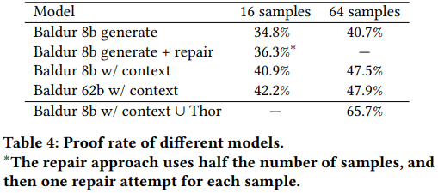
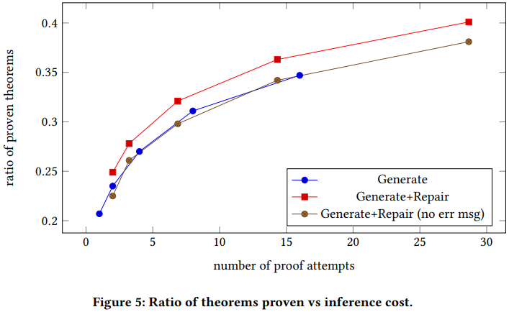
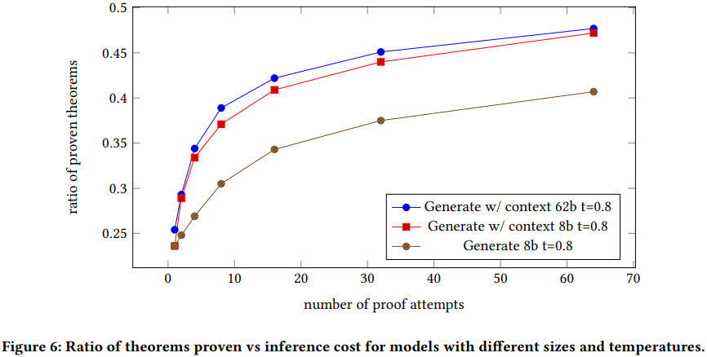
Experimental Results

Slide 42
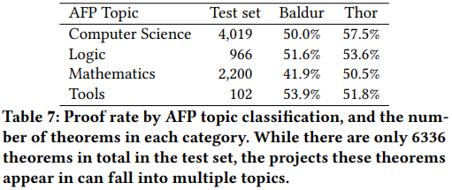
Experimental Results (2)
Baldur vs. Thor
Thor 57%
Baldur 47.9%

